Slide 1
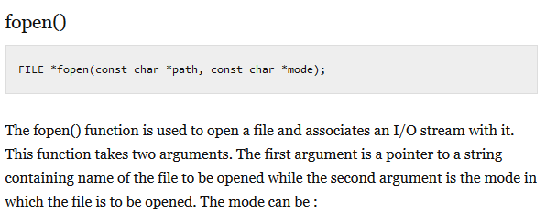

Slide 2
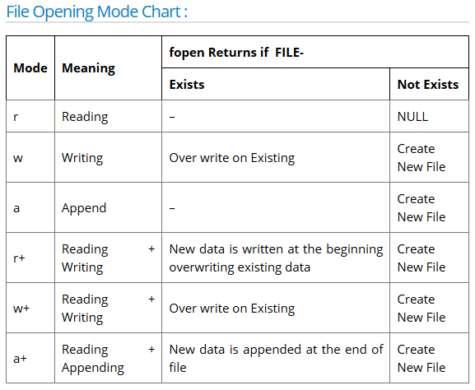

Slide 3
programs
file_simple.c
file_read.c

Slide 4
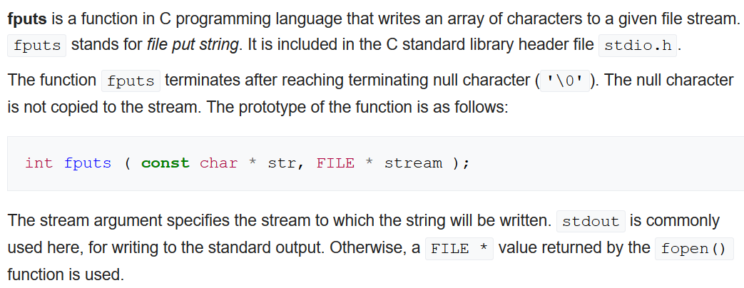
fputs()

Slide 5
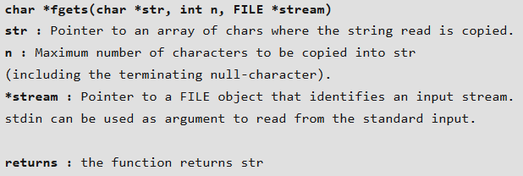
fgets()
It follow some parameter such as Maximum length, buffer, input device reference.
It is safe to use because it checks the array bound.
It keep on reading until new line character encountered or maximum limit of character array.

Slide 6
programs
fgets.c
fgets1.c
read_write.c

Slide 7
fscanf()
The fscanf() function is used to read set of characters from file. It reads a word from the file and returns EOF at the end of file.
Syntax:-
int fscanf(FILE *stream, const char *format [, argument, ...])
fprintf()
The fprintf() function is used to write set of characters into file. It sends formatted output to a stream.
Syntax:
int fprintf(FILE *stream, const char *format [, argument, ...])

Slide 8
programs
file_fscanf.c
file_fprintf.c

Slide 9
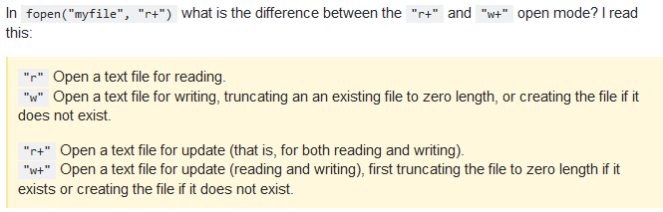
r+.c
Notes:
r+ don’t create the file if not exist

Slide 10
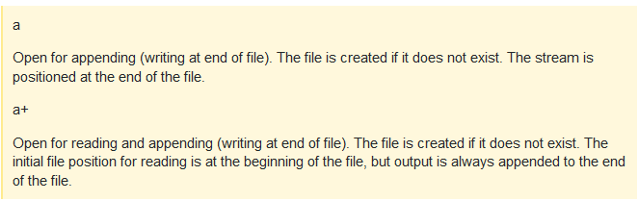

Slide 11
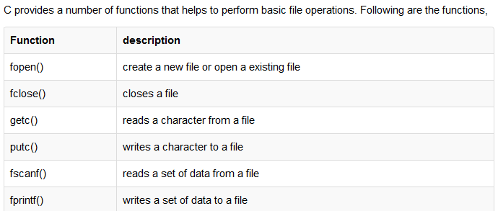


Slide 12
Random Access To File
There is no need to read each record sequentially, if we want to access a particular record. C supports these functions for random access file processing.
fseek()
ftell()
rewind()

Slide 13

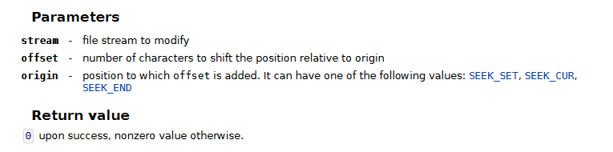

fseek()

Slide 14
PROGRAMS
file_seek_SET.c
file_seek_END.c
file_seek_CUR.c

Slide 15
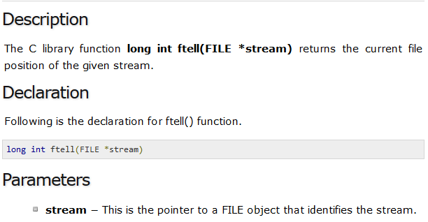
ftell()
file_ftell.c

Slide 16
rewind()
This function is used to move the file pointer to the beginning of the given file. Syntax: rewind( fptr); Where fptr is a file pointer.
rewind.c

Slide 17

file_getc_putc.c

